Slide 1
HR Data Tech:
Employee Performance and Satisfaction Analysis
BY: Group 2

Slide 2

Introduction:
HR Analytics, refers to the process of collecting, analyzing, and interpreting data related to the human resources (HR) functions within an organization. Its primary purpose is to use data-driven insights to improve decision-making in areas such as employee performance, engagement, retention, and overall workforce management.

Slide 3
Table of content:
Objectives.
Business questions , Planning.
Project Work-flow Chart.
project proposal.
Data Analysis.
Visualization Insights and recommendations.

Slide 4

Objectives:
Analyze HR DATA set.
Observe Insights and identify inefficiencies.
Identify Key drivers of improvement.
Recommend actions needed for achieving both company goals and employee's satisfaction.
Support stakeholders in decision making

Slide 5
Business Questions and Planning:
Employees Overview Insights.
Employees’ work environment Satisfaction.
Employees’ performance through Average manger rating.
Monitor Rate of Recruitment and Retention.
Percentage of attrition rate , relation between attrition rate and salary range.
Key Influences salary Ranges.
Diversity Index of employees.

Slide 6
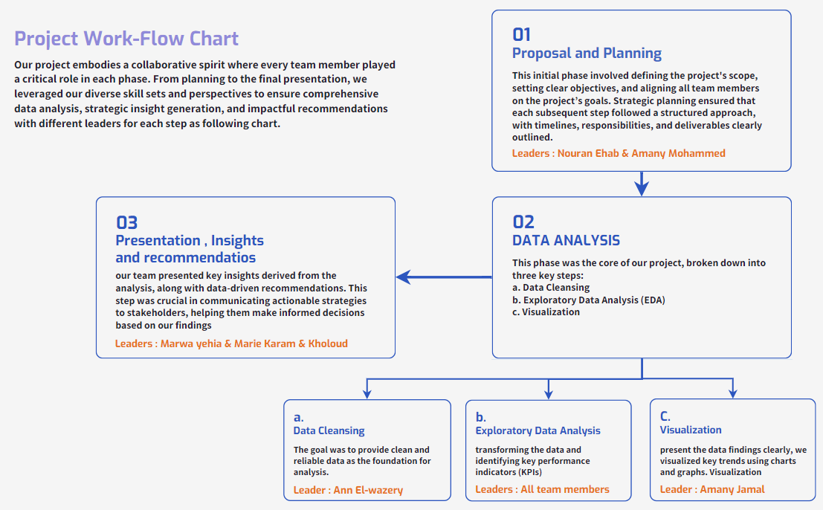
Project Work-Flow Chart

Slide 7
Project Proposal
Outlining everything stakeholders should know about the project, including objectives, and goals.
Project Proposal Content
Introduction.
Objective.
Purpose.
Visualization Plan.
Expected Outcomes.
Next Steps.

Slide 8





Data Analysis Steps
Data Collecting
Data Cleansing
ANALYSIS STEPS
Data Model
Data Analysis

Slide 9

Data Collecting
We have collected HR data files in CSV format from Kaggle.
Data Cleansing
1.We checked each table data quality .
2.We checked data type of each column and update the mismatch .
3.No errors were detected in data.
4.We have removed the duplicates.
5.Missing data was found.
6.We filtered out the blank values.

Slide 10
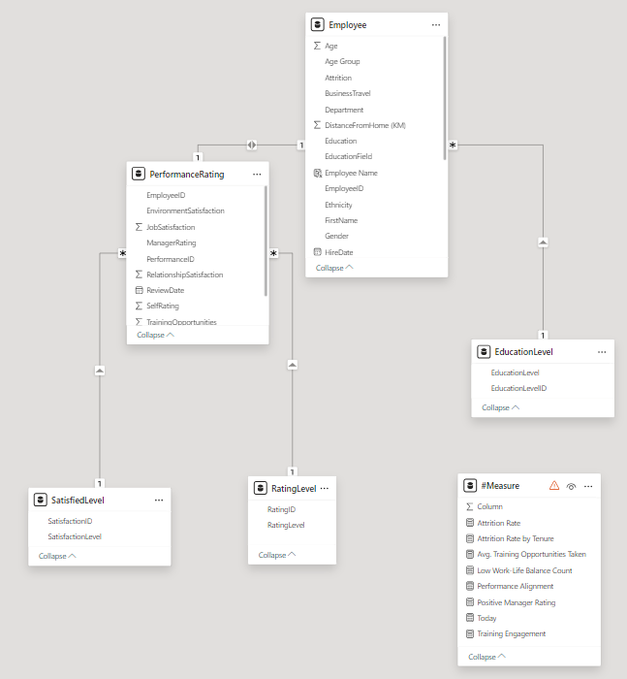
Data Model
We divided the data into:
Fact Table : Employee Table which include most of data.
Four Dimension Tables : Education level , Satisfied level , Performance rating , Rating level.
All organized in snow-flake Schema where performance dimension table is broken down into two tables ( Satisfied level and Rating level)

Slide 11
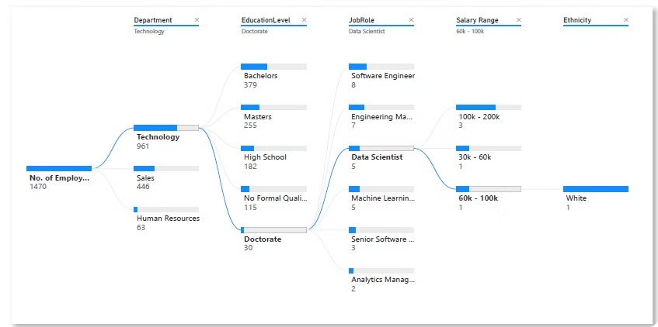
Data Analysis Insights and Recommendations
Employees Overview Insights
this decomposition tree provides overview of number of employees(1470), their distribution on departments (technology,sales,HR), their job role,salary range and ethnicity

Slide 12
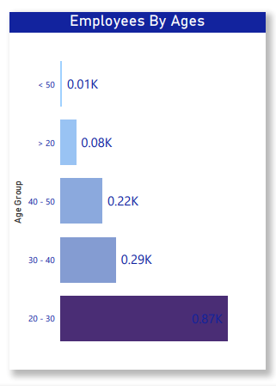
Data Analysis Insights and Recommendations
Workforce Age Distribution
Largest Age Group
The 20-30 age group represents the largest portion of our workforce.
Age Diversity
Our employee population spans a range of age groups, reflecting a diverse workforce.
Smaller Age Groups
Older and younger age groups make up smaller proportions of our team.

Slide 13
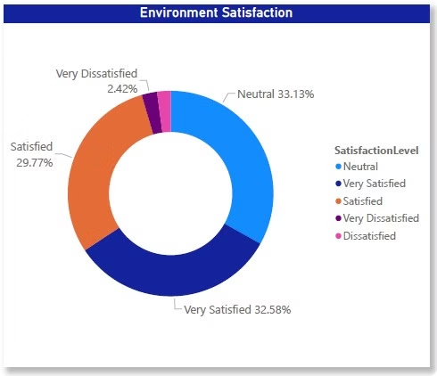
Data Analysis Insights and Recommendations
Enviromental Satisfaction
A majority of employees (65.71%) express neutral or positive sentiments about their work environment, with "Neutral" being the most common response (33.13%). A smaller percentage of employees (2.42%) are "Very Dissatisfied“
Business Insights:
1-Positive Environment
2-Areas for Improvement
Recomendations:
Employee Surveys
Focus Groups
Action Planning

Slide 14
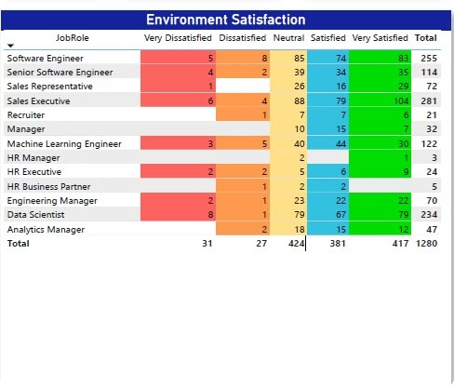
Data Analysis Insights and Recommendations
Job Role Satisfaction Analysis
Business Insights:
1.High Satisfaction
Software Engineers and Data Scientists report the highest levels of satisfaction with their work.
2.Neutral Sentiment
Sales Representatives, Recruiters, and HR Executives express more neutral or mixed feelings about their roles.
Recommendations:
1-Tailored Approach Based on Job Roles:
Since satisfaction levels vary by job role, HR should consider tailoring engagement and satisfaction initiatives to different teams.
2-Focus on Sales and HR Departments
3-Recognize and Reward Positivity in Key Roles

Slide 15
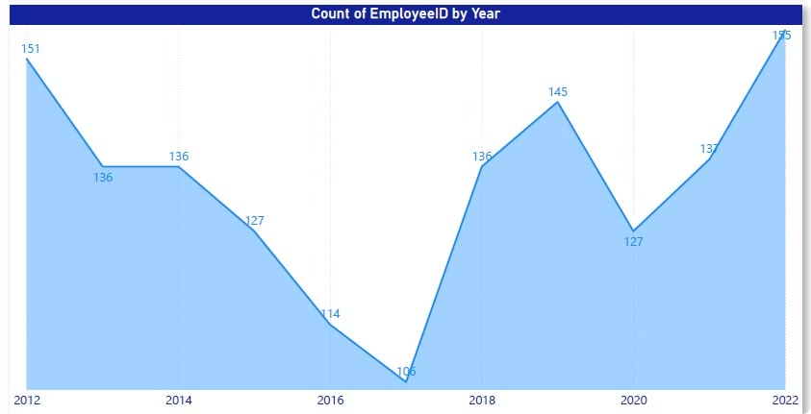
Employee Count Trend Analysis
1
2012
Employee count started high, reflecting rapid growth.
2
2015
Decline period as the company faced challenges.
3
2018
Recovery and steady growth as the business stabilized.
4
2022
Continued fluctuations in employee count over the years.

Slide 16
Employee Count Trend Analysis
Insights and Recomendations
Insights:
1.Significant Fluctuations
Recent growth
retention and turnover concern
2.Recomendations
Retention Initiatives
Sustaining Growth
Address Historical Turnover Issues
Monitor Future Trends

Slide 17
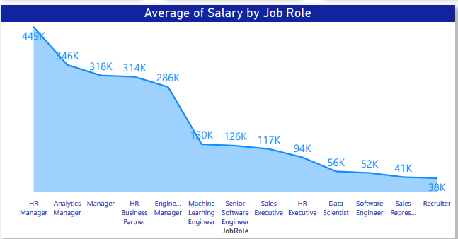
Salary Analysis
Insights
1.Highest-Paying Roles
Our analysis reveals the top-earning job functions, with certain technical and leadership roles commanding the highest average salaries.
2.Salary Disparity
Significant pay gaps exist between some roles, highlighting the need for more equitable compensation practices.
3.HR Salaries
Salaries for HR professionals fall within the mid-range, reflecting the importance of this function but also potential areas for improvement.

Slide 18
Salary Analysis
Recommendations:
1. Compensation Benchmarking: Regularly benchmark salaries against industry standards to ensure competitiveness and attract top talent.
2. Compensation Review: Conduct a comprehensive review of the compensation structure to identify and address any inequities.
3. Career Development Programs: Implement career development programs to help employees acquire the skills and experience needed to advance in their careers and increase their earning potential.

Slide 19
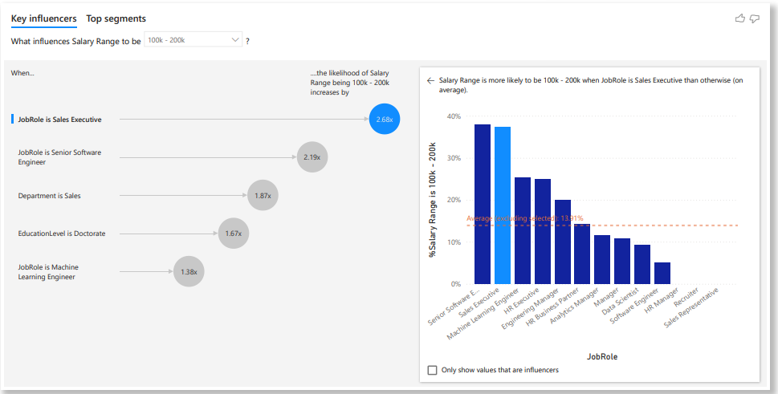
Factors Influencing High Salaries
100K
80%
70%
Job Roles and Skills
Departmental Influence
Education and Qualifications
Certain technical and leadership roles command the highest salaries, reflecting the value of specialized skills.
An employee's department plays a significant role in determining their earning potential.
Advanced degrees and professional certifications are key factors in higher salary ranges.

Slide 20
Recommendations:
1. Skill Development: Encourage employees to develop skills in high-demand job roles to increase their earning potential.
2. Career Path Planning: Provide career path guidance and support to help employees identify opportunities for advancement and skill development within the organization.
3. Education and Training: Invest in employee education and training programs to equip them with the necessary qualifications and certifications.
4. Compensation Review: Regularly review compensation structures to ensure that salaries are aligned with market standards and reflect the value of specific skills and experience.
5. Departmental Analysis: Analyze the factors that contribute to higher salaries within the "Sales" department to identify best practices and potential areas for improvement in other departments

Slide 21
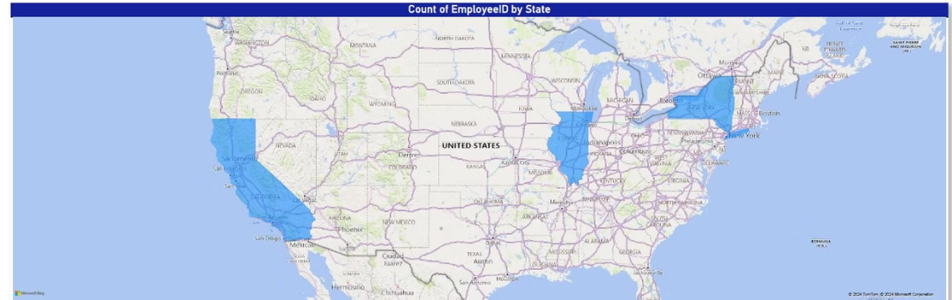
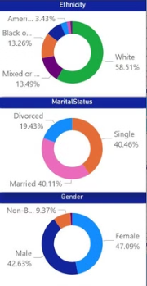
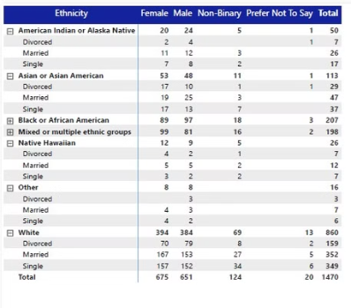
Workforce Demographics
Insights:
1.Ethnic Representation
Our workforce reflects a diverse ethnic makeup, with varying proportions across groups.
2.Gender Distribution
The gender identity of our employees is distributed across male, female, and non-binary
categories.
3.Marital Status
Employees have a range of marital statuses, including single, married, and other
categories.
Recommendations:
Diversity Hiring Initiatives:
Retention of Minority Groups
Support for Single Employees

Slide 22
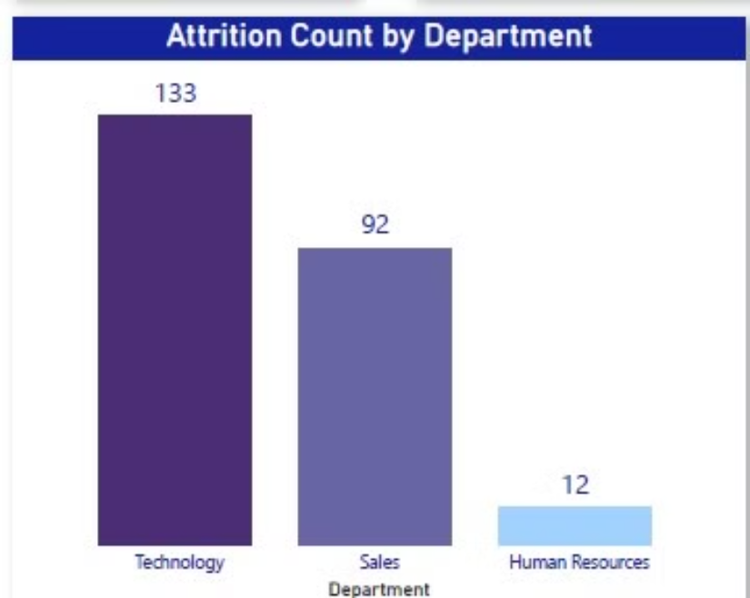
Attrition Analysis (Departmental)
Technology
Sales
Human Resources
The Technology department has the highest employee attrition rate, indicating a need for further investigation and targeted retention strategies.
Attrition in the Sales department is moderate, suggesting potential areas for improvement in employee engagement and management.
The Human Resources department has the lowest attrition rate, reflecting a more positive work environment and effective retention efforts.

Slide 23
Recommendations:
1.Departmental Investigation: Conduct a thorough investigation into the reasons for high attrition in the Technology department.
2.Employee Engagement Initiatives: Implement initiatives to improve employee engagement and satisfaction in the Technology department.
3.Compensation and Benefits Review: Evaluate the compensation and benefits packages offered to employees in the Technology department
4.Management Training: Provide management training to supervisors and team leaders in the Technology department
5.Retention Strategies: Develop and implement retention strategies tailored to the specific needs of the Technology department.

Slide 24
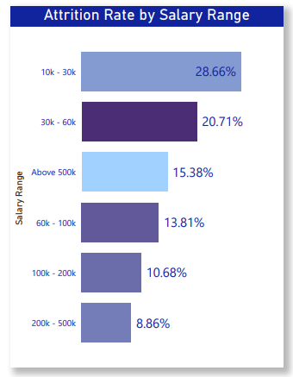
Attrition Analysis (Salary Range)
Highest Attrition
Employees in the lowest salary range have the highest attrition rates.
Decreasing Attrition
Attrition decreases as salary ranges increase, indicating a correlation between compensation and retention.

Slide 25
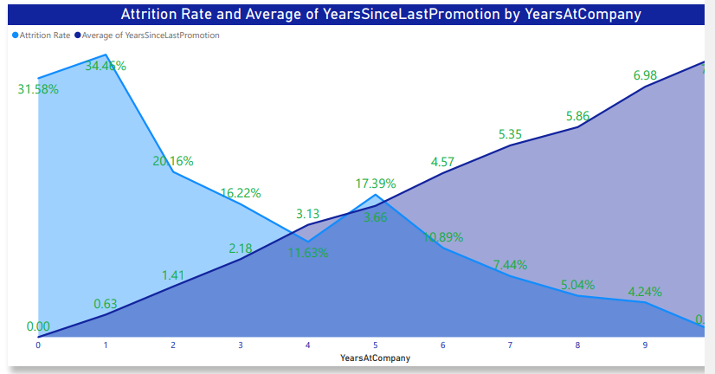
Attrition and Promotion History
Short Tenures
Promotion Impact
Employees with the least time since their last promotion have the highest attrition rates.
The data suggests that timely promotions and career advancement opportunities are key to retaining top talent.
1
2
3
Inverse Relationship
Attrition decreases as the average years since last promotion increase across different tenure levels.

Slide 26
Recommendations:
Promotion Policies: Review and refine promotion policies to ensure that employees are evaluated fairly
Career Development Programs: Implement career development programs to help employees identify their career goals.
Performance Management: Establish a robust performance management system to provide regular feedback, coaching, and development opportunities to employees.
Recognition and Rewards: Implement a recognition and reward system to acknowledge and celebrate employee achievements and contributions.
Exit Interviews: Conduct exit interviews with departing employees to gather feedback on their reasons for leaving and identify areas for improvement in retention efforts.

Slide 27
Thanks

